Slide 1
Quick Response code (QRcode)
generation
By HarshaVardhan Korrapati

Slide 2
Qr code introduction
☞ QR code was firstly designed in 1994 in Japan in the automotive industry.
☞ It is a type of barcode matrix that can help us to store the details.
☞ In this we are going to see how to generate QR code in python.
☞ we can store every detail of us in the form of QR code that may be personal details,
product details, other info.
☞ we can share the QR code with others easily.
☞ To read QR codes you need to install QR code scanners from playstore or iOS store.

Slide 3
Modules needed for this project
☞qrcode
pip install qrcode
☞Pillow
pip install Pillow
☞pyzbar
pip install pyzbar

Slide 4
Generate QR code with some text
Code:
import qrcode
qr = qrcode.make('harshaisking')
qr.save('harsha.png')
qr.show()

Slide 5
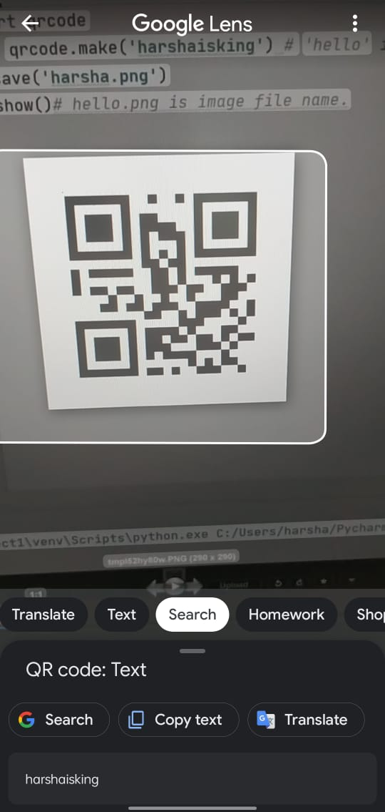

Slide 6
Generate QR code with links
Code:
import qrcode
data = 'https://youtu.be/JtzsSL2w-RY'
qr = qrcode.make(data)
qr.save('myyoutubevideo.png')
qr.show()

Slide 7
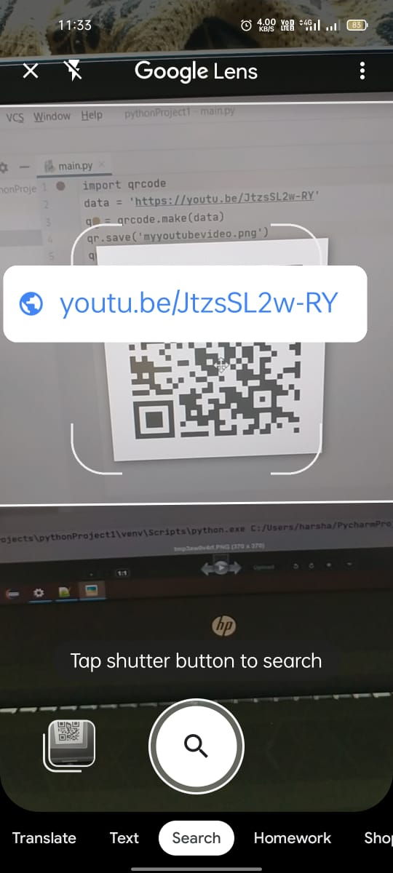

Slide 8
Styling your QR code
Code:
import qrcode
qr = qrcode.QRCode(
version=5,
box_size=5,
border=2
)
data = 'https://youtu.be/JtzsSL2w-RY'
qr.add_data(data)
qr.make(fit=True)
img = qr.make_image(fill_color='green',back_color='white')
img.save('myyoutubeqrwithstyle.png')

Slide 9
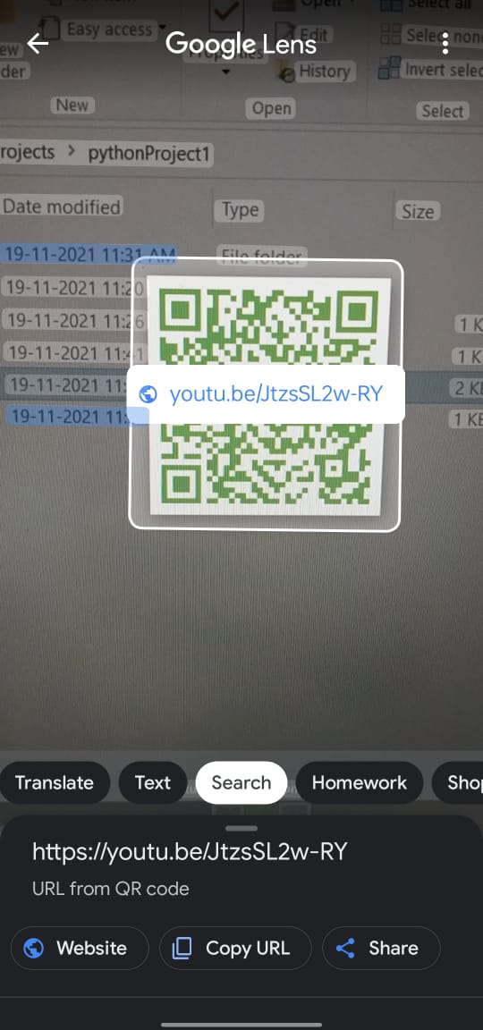

Slide 10
Generate QR code with user input data
Code:
import qrcode
qr = qrcode.QRCode(
version=5,
box_size=5,
border=2
)
name = input('Enter Name:')
age = int(input('Enter Age:'))
Education = input('Enter Ed.Qualification:')
data = {'name':name,'age':age,'edu':Education}
qr.add_data(data)
qr.make(fit=True)
img = qr.make_image(fill_color='black',back_color='white')
img.save('student.png')
img.show()

Slide 11
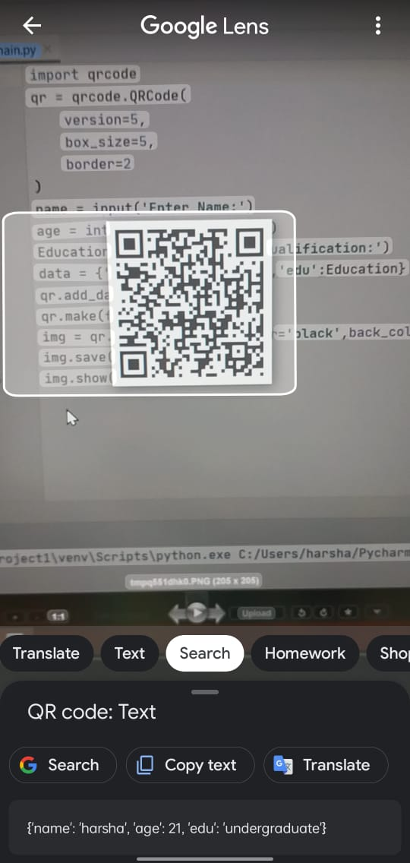

Slide 12
Read QR code data using python
Code:
import qrcode
from pyzbar.pyzbar import decode
from PIL import Image
import ast
data = decode(Image.open('student.png'))
info = data[0].data.decode('ascii')
data = ast.literal_eval(info)
print(data['name'].upper())
print(data['age'])

Slide 13
It reads the data from the png file.
It displays the output.
It is useful in the many daily situations when using this qr code technology.

Slide 14
Thank You

